Slide 1

ELL Leadership Academy
Karina E. Chapa, M.Ed.
Language Proficiency, Biliteracy and Cultural Diversity Director
kchapa@esc1.net
Twitter @esc1bilingual @bilingualpride

Slide 2

Professional Learning Essential Agreements
Be respectful of others
Be an active participant
Take care of your needs
Use electronic devices as learning tools

Slide 3

Edmodo Code: ktms9k
Post an idea that called your attention from Chapters 2 or 3.
Respond to someone else’s comment.
www.edmodo.com

Slide 4

Designated Supports Review
Scan the QR Code or go to: https://tinyurl.com/ELLRGCCISD
Type something you remember from Day 3 of the Academy

Slide 5
ELL Accountability
New Accountability Domains and PBMAS

Slide 6
Session Objectives
Content Objective
Today I will analyze different accountability systems and the impact they have on the instruction of English Language Learners.
Language Objective
Today I will discuss how different accountability systems impact my school and my district.

Slide 7
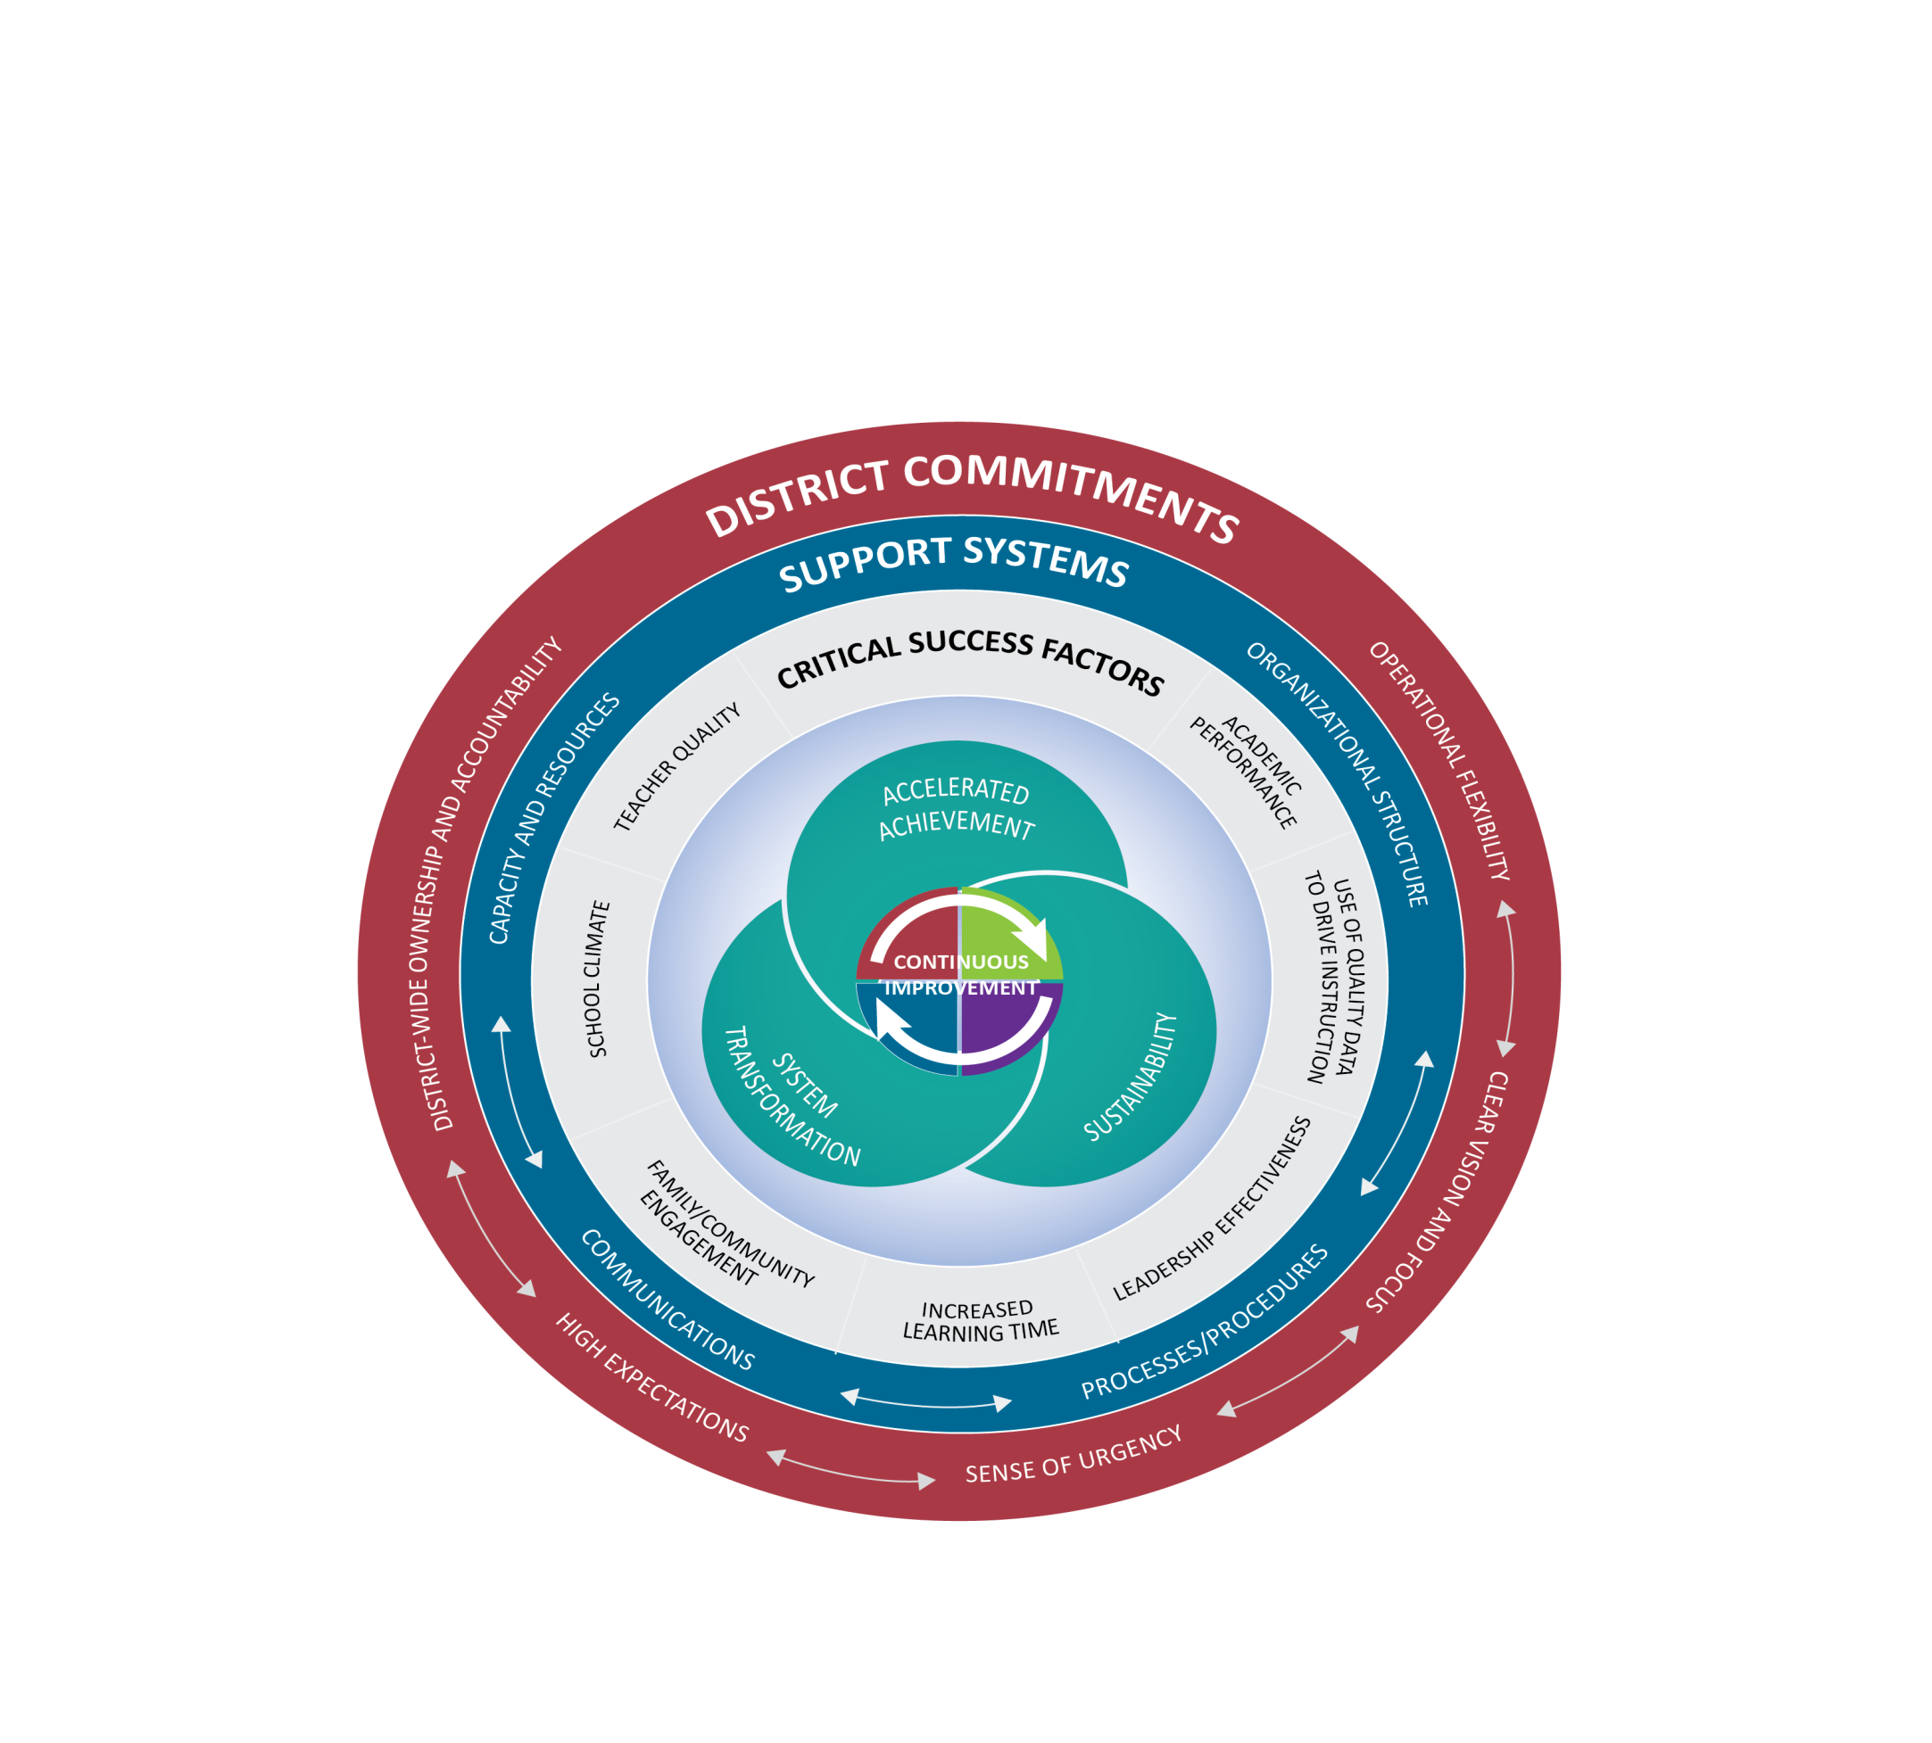
Texas Accountability Intervention System (TAIS)
Notes:
Presenter Talking Points:
The Texas Accountability Intervention System is a research based approached to school improvement that engages the district and school in the improvement process. The framework outlines five systemic components regarding district-level commitments, four support system components to be implemented at both the district and campus levels, and seven factors know to be critical to campus success. Planning for continuous improvement through the lens of these District Commitments, Support Systems and Critical Success Factors will result in the outcomes of accelerated achievement, sustainability, and system transformation.
The Framework for district and school support was developed collaboratively between the TEA and TCDSS. Local ESCs continue to develop tools and support for districts and campuses that align with framework that drives continuous improvement.
All of these elements are part of a healthy system for improvement. It takes each part of the system operating together for school success.
I have a short video to share with you that gives an overview of this framework.

Slide 8
STATE ACCOUNTABILITY
Indexes and Systems Safeguards

Slide 9
Index Framework

Slide 10
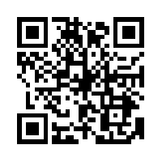
Indexes and safeguards reports
https://rptsvr1.tea.texas.gov/perfreport/account/

Slide 11
Region One ESC

Slide 12
Index 1

Slide 13
Index 1
-16%
-18%
-10%

Slide 14
Index 2
-1%

Slide 15
Index 2
-2%
+1%
-3%
+1%
-2%
+1%

Slide 16
Safeguards

Slide 17
2018 A-F SYSTEM
Implementation of House Bill 22

Slide 18



A–F Accountability: Legislative Context
HB
2804
HB
22
House Bill 22, 85th Texas Legislature
The commissioner shall evaluate school district and campus performance and assign each district and campus an overall performance rating of
A B C D or F
Notes:
House Bill 22, just like HB 2804 (its predecessor) requires the commissioner to evaluation district and campus performance and assign grades of A, B, C, D, or F.

Slide 19
A–F Accountability:
New Labels/Grades
A = Exemplary Performance
B = Recognized Performance
C = Acceptable Performance
D = In Need of Improvement
F = Unacceptable Performance

Slide 20


A–F Accountability:
Stakeholder Input
House Bill 22, 85th Texas Legislature
“The commissioner shall solicit input statewide from persons . . . , including school district boards of trustees, administrators and teachers employed by school districts, parents of students enrolled in school districts, and other interested stakeholders.”
Feedback Opportunities
Will solicit input on the aspects over which commissioner has authority
Won’t solicit input on aspects that are required by statute
Administrators
Teachers
Parents
Trustees
Notes:
HB 22 mentions getting feedback from stakeholder or committees three separate times.

Slide 21


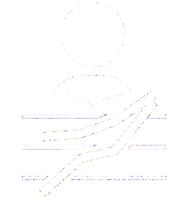
Three Domains:
Combining to Calculate Overall Score
Best of Achievement or Progress
Minimum 30%
Feedback Opportunities
Certain methodology decisions in each domain
Cut points for each grade in each domain
Weight (30% or more) to Closing the Gaps Domain
Student Achievement
School
Progress
Closing
The Gaps
Notes:
To calculate the overall grade, TEA will use the best of the Student Achievement domain or School Progress domain and combine it with the grade of the Closing the Gaps domain, which must account for at least 30% of the overall grade.
This can only be applied to districts or campuses that do not have an F in either the student achievement or school progress domain. If a district or campus receives an F in either of those two domains, TEA will use a grade of no greater than B for that portion of the overall grade.

Slide 22


Texas Higher Education Strategic Plan: 2015-2030
Expert Gallery Walk
WS# 69360

Slide 23
Student Achievement: Performance
School
Progress
Closing
The Gaps
Student Achievement

Slide 24


Student Achievement: Calculating Score
Texas Higher Education Coordinating Board
By 2030, at least 60 percent of Texans ages 25–34 will have a certificate or degree.
Student Achievement Score
A
 | All Students
Total Tests | 3,212
# Approaches Grade Level or Above | 2,977
# Meets Grade Level or Above | 1,945
# Masters Grade Level | 878
%
%
%
Average of 3
92.7 + 60.6 + 27.3
/ 3
= 60.2
Approaches Grade Level or Above
92.7%
Meets Grade Level or Above
60.6%
Masters Grade Level
27.3%
Notes:
To calculate the STAAR portion of the Student Achievement domain, TEA will average the percentage of students who achieve each of the three performance levels: approaches grade level, meets grade level, and masters grade level.

Slide 25
STAAR Component
All tests (STAAR with and without accommodations and STAAR Alternate 2) combined
All subjects combined
ELs (except in their first year in US schools)
Specific EL performance measures for year two in US schools only
Three Performance Levels
  Approaches Grade Level and Meets = HB 22
  Masters Grade Level = Commissioner
  The average of three levels is very close to the % Meets standard.
  Meets standard = 60% chance of completing one year of college without remediation.
  Masters = 75% chance.

Slide 26




Student Achievement: Calculating Score
Elementary School
Middle School
College, Career, Military Ready (CCMR)
Graduation Rates
Feedback Opportunity
Weighting of three
high school components
High School
Notes:
For elementary schools and middle schools, the STAAR is the only component.
For high schools and districts, there are three components: STAAR; college, career, and military ready (CCMR); and graduation rates.

Slide 27
Student Achievement:
CCMR Indicators for HS
College Ready
Meet criteria on AP/IB exams
Meet TSI criteria (SAT/ACT/TSIA) in reading and mathematics
Complete a college prep course offered by a partnership between a district and higher education institution as required from HB5
Complete a course for dual credit
Complete an OnRamps course
Earn an associate’s degree
Meet standards on a composite of indicators indicating college readiness
Career Ready
Earn industry certification
Be admitted to post-secondary industry certification program
Military Ready
10. Enlist in the United States Armed Forces

Slide 28

Calculating the Score: Stakeholder Input
= 100% of domain score
Elementary School
= 100% of domain score
Middle School
Different weights or logic?
= ?% of domain score
CCMR
Graduation Rates
= ?% of domain score
= ?% of domain score
High School
Notes:
Feedback is needed from you regarding the weights associated with high schools/k-12s/and districts for the Student Achievement domain. The commissioner wants to emphasize the CCMR component, so we should expect a substantial weight be given to this component.

Slide 29
School Progress: Growth
Student Achievement
Closing
The Gaps
School Progress
Notes:
The School Progress domain is the second of the three domains established by House Bill 22

Slide 30

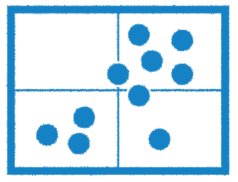
School Progress:
Two Aspects to Progress
Part A: Student Growth
Part B: Relative Performance
Notes:
When we think about School Progress, we think about the impact on students: how much are they growing
House Bill 22 establishes two ways to evaluation this.
Student Growth: how much has each individual student grown academically over last year—longitudinal student growth
While this is really good information to have, this metric has some limitations: because there are no STAAR test until third grade, we can’t determine level of growth using this metric until fourth grade, and high school has only a few STAAR test, so it’s not a very effective measure there either.
Relative performance is a different way of looking at growth by comparing the performance of similar campuses against each other.

Slide 31
School Progress:
Two Aspects to Progress
Part A: Student Growth
Notes:
We’ll start our look at the School Progress domain by exploring Part A: Student Growth

Slide 32
STAAR:
Test Inclusion Methodology
Includes all tests (STAAR with and without accommodations and STAAR Alternate 2) combined
Combines reading and mathematics
Uses STAAR Progress Measure
Includes ELs (except in their first year in US schools)
Uses same STAAR Progress Measure for ELs and non-Els
Because the first STAAR tests are given in third grade, we can’t assess growth using the STAAR Progress Measure until fourth grade.
At this point, only Relative Performance will be analyzed in high school.
Notes:
First, what are we including in Part A: what test do we have to make accurate conclusions about student growth
Part A includes all types of STAAR tests, those without accommodations, with accommodations, and STAAR Alt 2
The subjects included are reading and mathematics, and we combine the tests, we don’t report them separately.
Part A takes into account the STAAR Progress Measure (the same one that we been using for several years)—it’s the same progress measure for ELs and non-ELs; we no longer use the ELL progress measure. This is new this year.
Because the first STAAR tests are given in third grade, we can’t assess growth using the STAAR Progress Measure until fourth grade.
We can’t measure growth in high school using the STAAR Progress Measure because high schools have very few STAAR tests.
At this point, only Part B: Relative Performance will be analyzed in high school.

Slide 33

Student Growth:
Measuring Advancement
Masters
Exceeds
+ 1 Point Awarded
For meeting or exceeding expected growth
Masters
Meets
Expected
Meets
+ .5 Points Awarded
For maintaining proficiency, but failing to meet expected growth
STAAR Performance Level
Maintains
Approaches
Approaches
Does Not Meet
+ 0 Points Awarded
For falling to a lower level
Does Not Meet
Limited
3rd Grade Example
4th Grade Example
Notes:
Here are a few examples of how Part A works.
The design of the new growth model is to reward students who achieve expected growth (1 point) and also reward students who stay at the same performance level year over year even if they don’t meet growth expectations.
A student who was at Approaches Grade Level last year and achieves the Meets Grade Level this year earns one point
A student who was at Approaches Grade Level last year, stays at Approaches Grade Level this year, but meets the STAAR Progress Measure expectation also earns one point.
A student who was at Approaches Grade Level last year, stays at Approaches Grade Level this year, but does not meet the STAAR Progress Measure expectation earns half a point for maintaining proficiency.
And a student who moves to a lower performance level between years earns no points.
We no longer award two points for exceeding STAAR Progress Measure expectations. This is very different from what we’ve done in recent years.

Slide 34
Student Growth:
Percentage of Students Gaining
Current Year
 | Does Not Meet Grade Level | Approaches Grade Level | Meets Grade Level | Masters Grade Level
Does Not Meet Grade Level | Met/Exceeded Growth Measure = 1 pt Did not meet = 0 pts | Met/Exceeded Growth Measure = 1 pt Did not meet = .5 pts | 1 pt | 1 pt
Approaches Grade Level | Met/Exceeded Growth Measure = 1 pt Did not meet = 0 pts | Met/Exceeded Growth Measure = 1 pt Did not meet = .5 pts | 1 pt | 1 pt
Meets Grade Level | 0 pts | 0 pts | 1 pt | 1 pt
Masters Grade Level | 0 pts | 0 pts | 0 pts | 1 pt
Previous Year
Notes:
Each test can earn one point, half a point, or no points depending on proficiency level and whether the STAAR Progress Measure was met.
This matrix shows the 20 different possible outcomes for each test.

Slide 35
School Progress:
Two Aspects to Progress
Part B: Relative Performance
Notes:
Part B of this domain looks at relative performance.

Slide 36
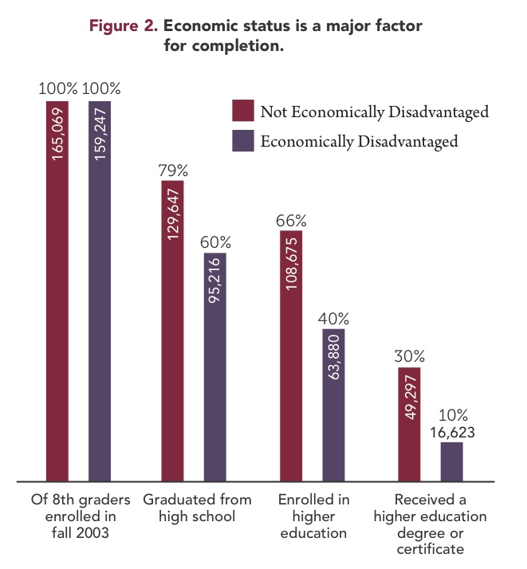
School Progress:
Two Aspects to Progress
Notes:
Part B of this domain looks at relative performance.

Slide 37
Relative Performance: Measuring School Progress
Higher Levels
of Student
Achievement
Student Achievement
Domain Score for All Students
Includes STAAR, CCMR, and graduation rates for districts and campuses that have that data
Higher Rates of
Economically
Disadvantaged Students
% Economically Disadvantaged Students
Notes:
The second part of the School Progress domain is relative performance, comparing the Student Achievement domain score against the percentage of students who are economically disadvantaged, then comparing that performance against like campus types.
The left axis is the score in the Student Achievement domain.
For elementary schools and middle schools, STAAR is the only component.
For high schools and districts, it’s STAAR, CCMR, and graduation rates
Along the bottom is the percentage of students who are considered economically disadvantaged
Each dot in this example represents an elementary campus, where each one falls is determined by its score in the Student Achievement domain and its percentage of students who are considered economically disadvantaged

Slide 38
Relative Performance: Measuring School Progress
Higher Levels
of Student
Achievement
Student Achievement
Domain Score for All Students
Includes STAAR, CCMR, and graduation rates for districts and campuses that have that data
Average Line
Higher Rates of
Economically
Disadvantaged Students
% Economically Disadvantaged Students
Notes:
So how can we compare performance of the green-dot campus and the red-dot campus?
It looks like the green-dot campus is out performing the red-dot campus in terms of proficiency, but is that really true in terms of the impact it has on students?
If we draw a line of best fit, it turns out that each campus is precisely average for all elementary campuses in Texas

Slide 39
Relative Performance: Measuring School Progress
Higher Levels
of Student
Achievement
A campus with fewer economically disadvantaged students on average has higher levels of student achievement.
Student Achievement
Domain Score for All Students
A campus with more economically disadvantaged students tends to have lower levels of student achievement.
Includes STAAR, CCMR, and graduation rates for districts and campuses that have that data
Average Line
Higher Rates of
Economically
Disadvantaged Students
% Economically Disadvantaged Students
Notes:
We know that, generally, a campus with fewer economically disadvantaged students has higher levels of student achievement.
And, generally, a campus with more economically disadvantaged students tends to have lower levels of student achievement.
But poverty is not destiny.

Slide 40
Relative Performance: Measuring School Progress
Higher Levels
of Student
Achievement
A
Student Achievement
Domain Score for All Students
B
C
D
F
Higher Rates of
Economically
Disadvantaged
% Economically Disadvantaged Students
Notes:
From that average line, we draw bands that determine grades.
We’re still working to determine where the cut points should be.
The slope of the lines will all be the same; grades will be determined by how far above or below the average line a district or campus falls.
This is an area where we would like feedback
When we run this for accountability, we’re planning several different scatterplots: one for elementary schools, one for middle schools, one for high schools/K–12, one for AEAs and one for districts.
We’ve looked at whether to use other characteristics in addition to percentage of economically disadvantaged students (English learners, Special Ed, etc.), but research has shown that the one characteristic that matters more than any other is the percentage of economically disadvantaged students.
We’re going to fix a distribution for the 2017–18 school year using data from 2016–17 accountability, then we’ll hold those cut points for hopefully five years.

Slide 41
Closing the Gaps:
Ensuring Educational Equity
Student Achievement
School
Progress
Closing
The Gaps
Notes:
A quick review: The new accountability system has three domains: Student Achievement, School Progress, and Closing the Gaps.
To calculate the overall grade, we’ll take the best of the first two domains and combine that grade with the grade in the Closing the Gaps domain.
A campus that earns a grade of C, B, or A is eligible to be assigned a grade based, in part, on a local accountability system.
Today, we’re going to explore the Closing the Gaps domain.

Slide 42






Closing the Gaps:
Ensuring Educational Equity
All Students
Continuously Enrolled
and Mobile
English
Learners (ELs)
Economically
Disadvantaged
Race/Ethnicity
Special Education
x
x
Notes:
This domain disaggregates data by student group, and is how we are planning to meet the requirements of ESSA
For this domain, we will look at fifteen individual student groups.

Slide 43
Closing the Gaps:
Ensuring Educational Equity
Student Groups
All Students
African American
Hispanic
White
American Indian
Asian
Pacific Islander
Two or More Races
Economically Disadvantaged
Current and Former Special Education
Current and Monitored English Learners
Continuously Enrolled/Non-Continuously Enrolled
Indicators
Academic Achievement in Reading, Mathematics, Writing, Science and Social Studies
Growth in Reading and Mathematics (Elementary and Middle Schools)
Graduation Rates
English Learner Language Proficiency Status
College, Career, and Military Readiness Performance
At or Above Meets Grade Level Performance in Reading and Mathematics
Notes:
These are the student groups and indicators we are evaluating for each student group.
I won’t read through the list of student groups. They are the same student groups that we use for accountability now, with two exceptions: former special education, continuously enrolled.
Academic achievement indicators based on STAAR scores in reading, math, writing, science, and social studies.
Growth based on STAAR scores for elementary schools and middle schools. This will be the same methodology used in the School Progress domain.
Graduation rates are specific to high schools.
English learner proficiency status
College, career, and military readiness. (high schools)
Grade level proficiency specific to reading and math. (elementary and middle schools)

Slide 44
Closing the Gaps:
Student Groups
Current and Former Special Education
Defined by HB 22
Formerly receiving special education services
  The student was reported in PEIMS the preceding year as enrolled at the campus and participating in a special education program.
  The student is reported (PEIMS and STAAR answer documents) as enrolled at the campus in the current year and not participating in a special education program.
  Current modeling shows that this affects approximately 110 districts and six campuses when a the minimum-size criteria of 25 is applied.
Feedback Opportunity
For how many years in the past should we check for participation in special education?
Notes:
Let’s take a look at a few of the new student groups that we will be using: House Bill 22 requires tracking current and former Special Ed students.
This will be the first time that former special education students are looked as a student group in the accountability system.
The challenge is that there are rarely enough kids to measure this at the campus level. Currently modeling shows us that, when minimum-size criteria is applied, only six campuses and 110 districts has sufficient data for this indicator. Our current modeling uses two years of former special education data. This is a feedback opportunity: for how long in the past should we look to include them in this group? Two, three, four, more?

Slide 45
Closing the Gaps:
Student Groups
Continuously Enrolled and Non-Continuously Enrolled
Not defined by HB 22
Districts
  Grades 4–12: Enrolled at a district in the fall snapshot in the current school year and each of the three previous years
  Grade 3: Enrolled at a district in the fall snapshot in the
  current school year and each of the previous two years
  Campuses
  Grades 4–12: Enrolled at a campus in the fall snapshot in the current school year and in the same district in each of the three previous years
  Grade 3: Enrolled at a campus in the fall snapshot in the current school year and in the same district each of the previous two years
Feedback Opportunity
Should we use an alternate definition?
If so, what?
Notes:
HB 22 also requires us to look at students who are continuously enrolled.
This is a tentative definition and we welcome feedback on how to improve it. This is a difficult measure especially at the campus level because of the number of different grade spans that the 8,600 or so campuses in Texas serve.
Here is how it works for districts: If a student in fourth grade or higher is in the district on the snapshot date, we look at back at each of the previous three years (four years total) to see if there were in the district on the snapshot date in each of those years. If he or she was, then he or she is counted as continuously enrolled. If not then the student is not counted as continuously enrolled. For students that are in third grade, we look at the current year and the previous two. Students in kindergarten, first grade, and second grade are not considered continuously enrolled.
Here is how it works for campus: If a student in fourth grade or higher is on the campus on the snapshot date, we look at back at each of the previous three years (four years total) to see if there were in the district on the snapshot date in each of those years. A student on a campus on the snapshot date and in the district in each of the previous three years is counted as continuously enrolled for the campus. If not then the student is not counted as continuously enrolled. For students that are in third grade, we look at the current year and the previous two. Students in kindergarten, first grade, and second grade are not considered continuously enrolled.

Slide 46




Closing the Gaps:
Continuously Enrolled in District
2017
2016
2015
2014
10th Grade
9th Grade
8th Grade
7th Grade
Continuously Enrolled
Notes:
Here’s an example for a district. Moving left to right, the student is in the district on the snapshot date in 2017 and was also in the PEIMS snapshot for the previous three years. This student is considered continuously enrolled.

Slide 47
Closing the Gaps:
Continuously Enrolled in District
2017
2016
2015
2014
10th Grade
9th Grade
8th Grade
Non-Continuously Enrolled
Notes:
Moving left to right, this student was in the district on the snapshot date in 2017 (10th grade) and was also in the PEIMS snapshot for only the previous two years. This student is considered non-continuously enrolled.

Slide 48
Closing the Gaps:
Continuously Enrolled in District
2017
2016
2015
3rd Grade
2nd Grade
1st Grade
Continuously Enrolled
Notes:
If, however, the student is in the third grade in the current year, we look back only two years. This student is considered continuously enrolled.

Slide 49
Closing the Gaps:
Continuously Enrolled in District
2017
2016
2015
3rd Grade
1st Grade
Non-Continuously Enrolled
Notes:
The 3rd grader in this slide is considered non-continuously enrolled because he or she does not have three continuous years in the district.

Slide 50

Closing the Gaps:
Continuously Enrolled at a Campus
2017
2016
2015
2014
10th Grade
9th Grade
8th Grade
7th Grade
Continuously Enrolled
Notes:
Here’s an example for a campus. Moving left to right, the student is on the campus on the snapshot date in 2017 and was also in the PEIMS snapshot for the district for the previous three years. This student is considered continuously enrolled.

Slide 51
Closing the Gaps:
Continuously Enrolled at a Campus
2017
2016
2015
2014
10th Grade
9th Grade
8th Grade
Non-Continuously Enrolled
Notes:
Moving left to right, this student was on the campus on the snapshot date in 2017 (10th grade) and was also in the PEIMS snapshot for the district for only the previous two years. This student is considered non-continuously enrolled.

Slide 52
Closing the Gaps:
Continuously Enrolled at a Campus
2017
2016
2015
3rd Grade
2nd Grade
1st Grade
Continuously Enrolled
Notes:
If, however, the student is in the third grade in the current year, we look back only two years. This student is considered continuously enrolled.

Slide 53
Closing the Gaps:
Continuously Enrolled at a Campus
2017
2015
3rd Grade
1st Grade
Non-Continuously Enrolled
Notes:
The 3rd grader in this slide is considered non-continuously enrolled because he or she does not have three continuous years in the district.

Slide 54
Closing the Gaps:
Student Groups
Current and Monitored ELs
Allowed by ESSA
Current ELs
ELs through their fourth year of monitoring.
Feedback Opportunities
Should we monitor for four years? Only two?
Should we report current and monitored ELs separately?
Notes:
Current modeling looks at both current ELs and current and monitored Els in two different groups. The combinations of “current and monitored” is required by federal law. We are not required by federal law to track current EL alone.
There are opportunities for feedback here regarding whether we need to track current ELs separately or just track the what is required by the federal requirement and for how long out we should track monitored EL students?

Slide 55
Closing the Gaps: Indicators
Academic Achievement
STAAR performance (percentage at or above Approaches Grade Level)
Targets by subject area
  English Language Arts/Reading
  Mathematics
  Writing
  Science
  Social Studies
  Targets stable for five years
  Safe Harbor/Required Improvement applied
Notes:
Now let’s look at the indicators in this domain. For the academic achievement indicator, we use performance on STAAR at the Approaches Grade Level performance standard for all subjects.
Targets will be held constant for five years, and safe harbor is available for each indicator; we’ll look at safe harbor in greater detail in a few moments.

Slide 56
Closing the Gaps: Indicators
Growth
Elementary and Middle Schools
  English Language Arts/Reading (School Progress domain)
  Mathematics (School Progress domain)
Graduation Rates
High Schools, K–12, Districts
  Federal graduation rates (without exclusions)
  Targets
  Stable for five years
  Safe Harbor/Required Improvement applied
Notes:
The growth indicator is based on our new growth model in the School Progress domain. We will only do this for English/language arts and mathematics.
You’ll remember from the School Progress domain TETN that growth is not a metric we have in high schools right now because there are not enough STAAR growth measures in high school to make it a reliable measure of growth. This is a feedback opportunity. Should we use it for high schools? Are there any other growth measures for high school?
The graduation rates we are using are the federal rates without the state exclusions.
The targets will stay static for five years, and safe harbor is available.

Slide 57
Closing the Gaps: Indicators
English Language Proficiency Status
TELPAS Progress Rate
Current ELs
Feedback Opportunity
Should we wait on TELPAS given changes in test this year? This would involve different standards within a 5 year window.
Notes:
TELPAS progress rate measures performance from prior to current year as demonstrated by increasing levels on the TELPAS.
TELPAS is changing; the listening and speaking portions are now administered online. Should we postpone our integration of TELPAS given these changes? We would have to adjust this domain in year two to address this. We have to supply the feds with something this year that measures English language proficiency status.

Slide 58
Closing the Gaps: Progress of ELs
EL Progress reflects an English Learner’s progress towards achieving English language proficiency.
Data source is TELPAS results.
Accountability subset rule is applied.
A student is considered having made the EL Progress if
  he/she advances by at least one score of the composite rating from the prior year to the current year, or
  his/her result is “Advanced High.”
If the prior year composite rating is not available, second or third year prior are used.
The minimum size is 25.
Small number analysis is applied if there are fewer than 25 current EL students.
Notes:
Here’s how we calculate the progress of ELs. [Read Slide]

Slide 59
Closing the Gaps: Indicators
School Quality or Student Success
High Schools, K–12, and Districts
  College, Career, and Military Readiness (Student Achievement domain)
  Targets stable for five years
  Safe Harbor/Required Improvement applied
Elementary and Middle Schools STAAR Grade 3–8 Performance
  Reading (percentage at or above Meets Grade Level)
  Mathematics (percentage at or above Meets Grade Level)
  Targets stable for five years
  Safe Harbor/Required Improvement applied
Notes:
For the school quality and student success indicator, we are using the same CCMR indicator that we use in the Student Achievement domain for high schools. For elementary and middle schools, we will be using the Meets Grade Level standard for reading and math.
The targets should be stable for five years.
Safe harbor is available.

Slide 60






Closing the Gaps:
Ensuring Educational Equity
Student Group
Achievement Target
% of Student Groups
that meet target
Overall
Grade
Feedback Opportunity
Percentage of student groups doesn’t count degree of challenge in any group. Should we attempt a more complicated formula? And should we weight a given cell type more than others?
Notes:
Those are the student groups and indicators that we are planning to use to align the state accountability system with the requirements of ESSA. For districts and campuses that have data for each of the student groups and each of the indicators will have something like 120 different data points.
One way to assign a grade for this domain is by looking at the percentage of data points that meet or exceed a target, but that doesn’t address by how much a target is missed. Here’s a feedback opportunity: should we consider by how much a target is missed or just the percentage of targets that are missed.

Slide 61

Closing the Gaps:
Aligning Accountability Systems
Closing
The Gaps
Notes:
For the first time in 15 years, we will have only one accountability system. Federal and state requirements both will be met in our new accountability system. The Closing the Gaps domain will be used to meet ESSA requirements.

Slide 62
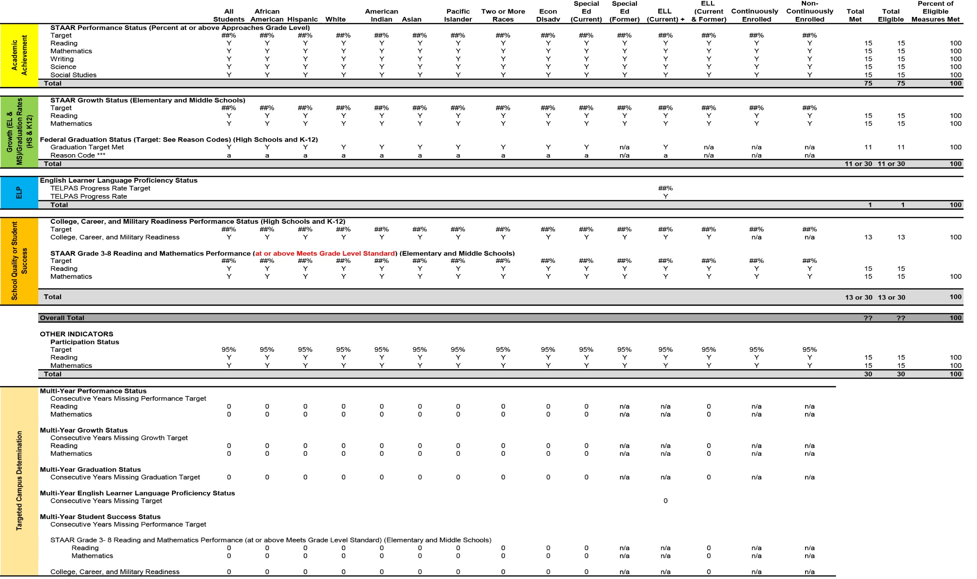
Closing the Gaps:
Sample Status Report
Notes:
This is one possible way to report outcomes. It shows the 120 different points for which a school or district may have data. It looks a lot like the system safeguard report that we use now. This slide shows only a few of the student groups for which we will collect data.

Slide 63
Closing the Gaps:
Sample Status Report
 |  | All | African
 |  | Students | American | Hispanic | White
Academic Achievement | STAAR Performance Status (Percentage at or above Approaches Grade Level)
 | Target | 80.0% | 80.0% | 80.0% | 80.0%
 | Reading | Y | Y | Y | Y
 | Mathematics | Y | Y | Y | Y
 | Writing | Y | Y | Y | Y
 | Science | Y | Y | Y | Y
 | Social Studies | Y | Y | Y | Y
Notes:
Here is a closer look at the academic achievement portion of the report. The performance target will be given in the top row of the report, and for each subject and student group, there will be a “y” if the performance target was met and an “n” if it wasn’t.
The targets shown in this and the following slides are from Texas’s Essa state plan.

Slide 64
Closing the Gaps:
Sample Status Report
 |  | All | African | African
 |  | Students | American | American |  | Hispanic |  | White
Growth (EL & MS)/ Graduation Rates (HS & K12) | STAAR Growth Status (Elementary and Middle Schools)
 | Target | 70.0% | ##% | 70.0% |  | 70.0% |  | 70.0%
 | Reading | Y | Y | Y |  | Y |  | Y
 | Mathematics | Y | Y | Y |  | Y |  | Y
 | Federal Graduation Status (Target: See Reason Codes) (High Schools and K–12)
 | Graduation Target Met |  | Y | Y | Y |  | Y
 | Reason Code |  | a | a | a |  | a
+ Graduation uses ELL (Ever HS) rate
***Federal Graduation Rate Reason Codes:
a = Graduation rate goal of 90% c = Safe harbor target of a 10% difference from the prior year rate and the goal
B = Four-year graduation rates target of ##% d = Five-year graduation rate target of ##%
Notes:
It’s the same for growth: the performance target will be given in the top of the report, and for each subject and student group, there will be a “y” if the performance target was met and an “n” if it wasn’t.
The graduation rate indicator will also have a “y” if the target was met, and an “n” if it wasn’t. The reason code for Graduation Target tells you how you met or did not the Graduation Target which could be via the 4-year, 5-year, or 6-year graduation rate.
Note: these use the federal definition for graduation rate—without state exclusions.

Slide 65
Closing the Gaps:
Sample Status Report
 |  | ELL
 |  | (Current)
ELP | English Learner Language Progress | 42.0%
 | TELPAS Progress Rate Target | Y
 | TELPAS Progress Rate | 42.0%
Notes:
This is the portion of the report that shows progress of ELs. Like the previous two slides, this will show the target and whether it has been met.

Slide 66
Closing the Gaps:
Sample Status Report
 |  | All | African
 |  | Students | American | Hispanic | Hispanic | White | White
School Quality or Student Success | College, Career, and Military Readiness Performance Status (High Schools and K–12)
 | Target | 40.0% | 40.0% | 40.0% |  | 40.0%
 | College, Career, and Military Readiness | Y | Y | Y |  | Y
 | STAAR Grade 3–8 Reading and Mathematics Performance (at or above Meets Grade Level Standard) (Elementary and Middle Schools)
 | Target | 45.0% | 45.0% | 45.0% |  | 45.0%
 | Reading | Y | Y | Y |  | Y
 | Mathematics | Y | Y | Y |  | Y
Notes:
For the school quality and student success part of the report, the performance target will be given in the top row of the report, and for each indicator and student group, there will be a “y” if the performance target was met and an “n” if it wasn’t.

Slide 67
Closing the Gaps:
Sample Status Report
Feedback Opportunity
Should we determine targeted schools based on overall student group performance, overall performance by indicator, or by each student group and each indicator?
Notes:
This is the section of the report where we will determine which campuses are targeted. It will be based on consecutive years of missing the target on at least one of these indicators. Here’s a feedback opportunity: Should we assign grades based on student group performance (basically the number of consecutive years that a student group did not meet the target on any indicator), overall performance by indicator (consecutive years that an indicator was missed by any student group), or by each student group and each indicator (three consecutive years of a specific student group missing the same indicator)?

Slide 68
Closing the Gaps:
Sample Status Report
Identification of Schools: Targeted Support and Improvement
Three consecutive years of missing a target in the same student group on the same indicator
Summer 2019 based on 2017, 2018, and 2019 data
z
 |  | All |  | All | African | African
 |  | Students |  | Students | American | American | Hispanic | Hispanic | White
Targeted Campus Determination | Multi-Year Performance Status
 | Consecutive Years Missing Performance Target
 | Reading |  | 0 | 0 | 0 | 0 | 0 | 0 | 0
 | Mathematics |  | 0 | 0 | 0 | 0 | 0 | 0 | 0
 | Multi-Year Growth Status
 | Consecutive Years Missing Growth Target
 | Reading |  | 0 | 0 | 0 | 0 | 0 | 0 | 0
 | Mathematics |  | 0 | 0 | 0 | 0 | 0 | 0 | 0
 | Multi-Year Graduation Status
 | Consecutive Years Missing Graduation Target |  | 0 | 0 | 0 | 0 | 0 | 0 | 0
 | Multi-Year English Learner Language Proficiency Status
 | Multi-Year Student Success Status
 | Consecutive Years Missing Performance Target
 | STAAR Grade 3- 8 Reading and Mathematics Performance (at or above Meets Grade Level Standard) (Elementary and Middle Schools)
 | Mathematics | 0 | 0 | 0 | 0 | 0 |  | 0 | 0
 | Reading |  | 0 |  | 0 |  |  | 0 | 0
 | College, Career, and Military Readiness | 0 | 0 | 0 | 0 | 0 |  | 0 | 0
Notes:
Here’s a closer look at the report. To determine which campuses have missed a target in the same student group on the same indicator for three consecutive years.
Summer 2019 based on 2017, 2018, and 2019 data

Slide 69
Closing the Gaps:
Alignment with ESSA
Identification of Schools: Comprehensive Support and Improvement
Lowest-performing five percent of campuses based on overall A–F grade
High schools with less than 67 percent graduation rate
Certain targeted schools that do not improve in a specified time
Beginning in summer 2018 based on 2017–18 data
Updated at least every three years thereafter
Feedback Opportunity
Should we identify these schools every year or every three years?
Notes:
Lowest-performing five percent of campuses based on overall A–F grade
High schools with less than 67 percent graduation rate
Certain targeted schools that do not improve in a specified time
Beginning in summer 2018 based on 2017–18 data
Updated at least every three years thereafter
Here’s an opportunity for feedback. Should we identify comprehensive schools every year, every other year, or every three years?

Slide 70
Closing the Gaps:
Safe Harbor Provision
Safe Harbor
To avoid unintended consequences and recognize improvement over time
Available for all indicators
For districts and campuses that do not meet the target on an indicator
District and campuses that miss a target will have no negative consequences if they make sufficient progress over the previous year.
The progress must be enough that (if continued at that rate) a district or campus would meet an interim or long-term goal in a specified amount of time.
Notes:
Each of these indicators will have the option of safe harbor. The whole purpose of safe harbor is to recognize improvement over time even if minimum proficiencies are not achieved. The concept of Safe Harbor dates back to AYP days. Here’s how its calculated.

Slide 71
Closing the Gaps:
Safe Harbor Calculation
Variables
Last year’s result
This year’s result
Goal (interim or long term)
Years to meet goal
Example One Scenario
Performance on mathematics STAAR by students in special education
Last year’s score (45)
This year’s score (53)
Goal (interim) (80)
Years to meet goal (5)
Example One Calculation
Last year’s result missed the target by 35 points (80 – 45 = 35)
Because the years to meet goal is 5, this campus must improve its score for this indicator by 7 points each year
(35  5 = 7).
This year’s score is 8 points better than last year’s (53 – 45 = 8)
Safe harbor is invoked.
There are no negative consequences of missing that target for this indicator.
Notes:
Rather than having a narrative that explains how safe harbor is calculated, we’ll explain it by using a few examples. [Read Through Examples]

Slide 72
Closing the Gaps:
Safe Harbor Calculation
Example Two Scenario
Performance on mathematics STAAR by students in special education
Last year’s score (60)
This year’s score (61)
Goal (long term) (90)
Years to meet goal (15)
Example Two Calculation
Last year’s result missed the target by 30 points (90 – 60 = 30)
Example Two Calculation (cont.)
Because the years to meet goal is 15, this campus must improve its score for this indicator by 2 points each year
(30  15 = 2).
This year’s score is 1 points better than last year’s (61 – 60 = 1)
Safe harbor is not invoked.
There are negative consequences of missing that target for this indicator.
Feedback Opportunity
Should we apply the same standard for expectation to all student groups, given safe harbor rules?
Notes:
Here’s a second example.
There’s a feedback opportunity here: should we apply the same standards to all student groups given that we have safe harbor?
Also, what’s the five-year and fifteen-year targets: a B? an A?

Slide 73
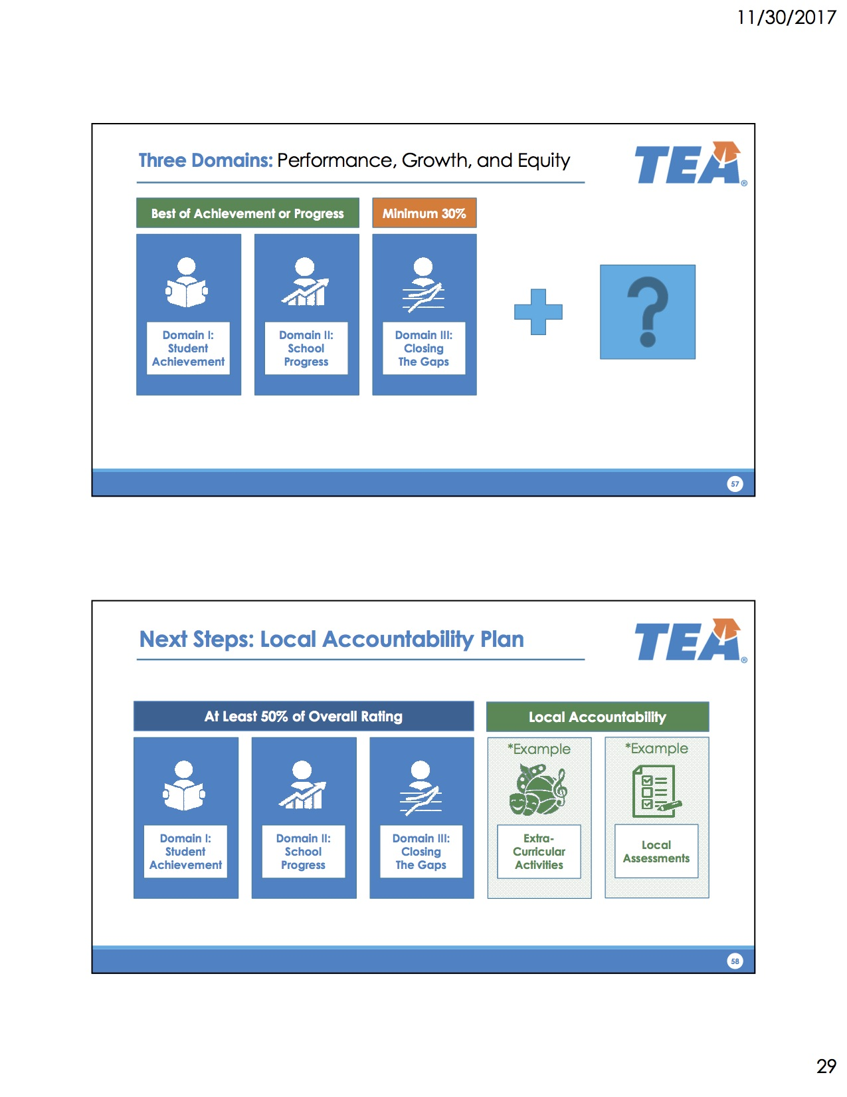
Three Domains:
Performance, Growth and Equity
Notes:
Here’s a second example.
There’s a feedback opportunity here: should we apply the same standards to all student groups given that we have safe harbor?
Also, what’s the five-year and fifteen-year targets: a B? an A?

Slide 74
Domain IV:
Local Accountability
Notes:
Here’s a second example.
There’s a feedback opportunity here: should we apply the same standards to all student groups given that we have safe harbor?
Also, what’s the five-year and fifteen-year targets: a B? an A?

Slide 75
State Accountability Videos
https://tea.texas.gov/A-F/

Slide 76
Let’s Reflect!
In your opinion, what is the biggest change in the state accountability system?
How is this change going to impact what you do at your campus?
What is the number one thing you have to do differently under this new system?

Slide 77
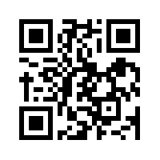
HB 22: NEW Accountability System
kahoot.it
create.kahoot.it

Slide 78
2017 PBMAS
Performance Based Monitoring Analysis System

Slide 79
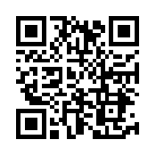
PBMAS Reports
https://goo.gl/RKDUya

Slide 80
Special Education
NCLB Title I Part A At Risk
Program Performance
&
Program Effectiveness
Bilingual ESL
NCLB Title I Part C Migrant
CTE

Slide 81
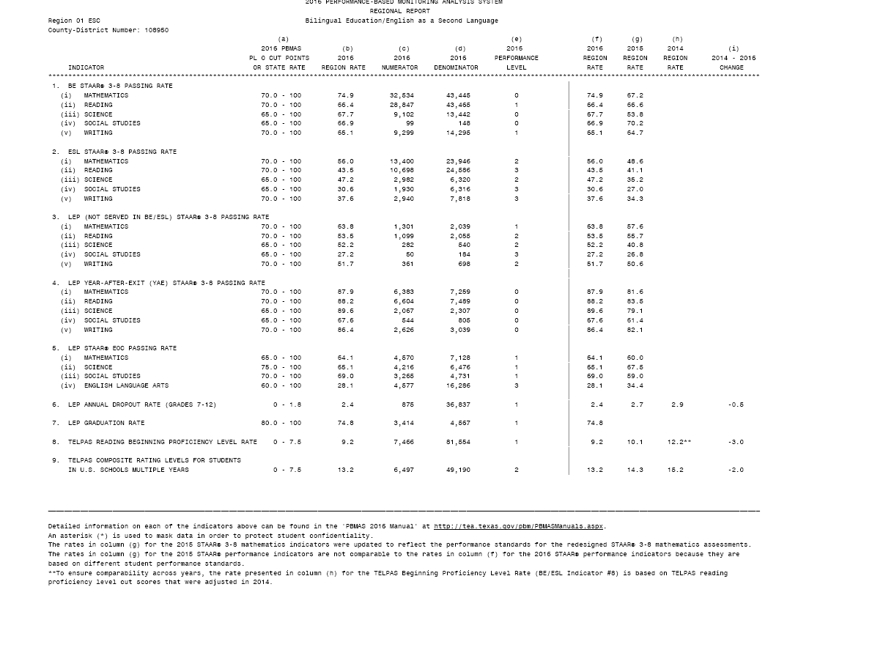
BE/ESL (Indicators 1-9)
ELLs are advancing academically as per STAAR performance
ELLs Not Served in BE or ESL are advancing academically as per STAAR performance
ELLs are graduating and not dropping out of school
ELLs grades 2-12 are not scoring beginning proficiency level for two consecutive years on TELPAS Reading
ELLs grades 5-12, 5 + years demonstrate progress on TELPAS Composite rating and are not continuing to be rated B or I

Slide 84
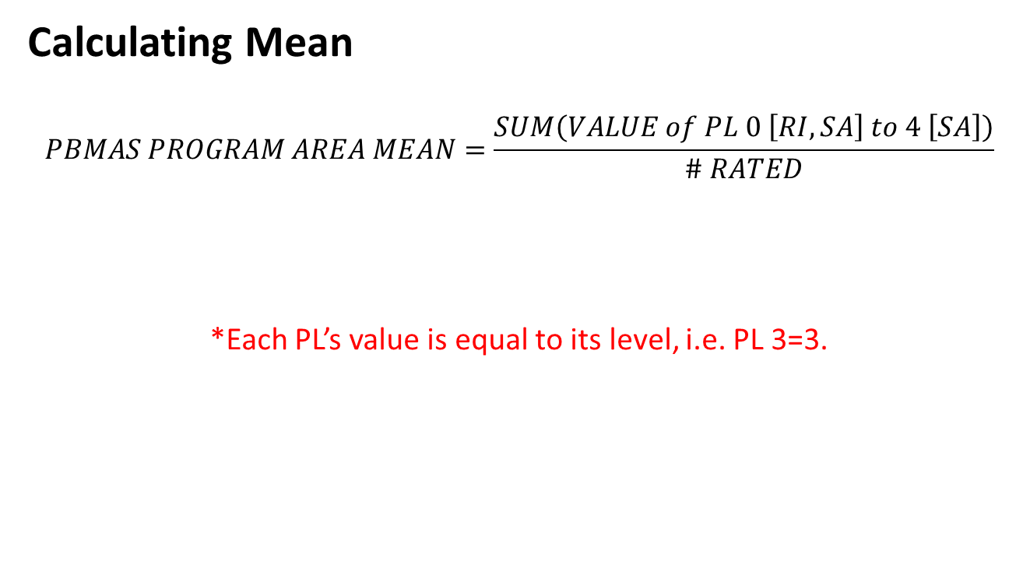
2017 Staging Framework

Slide 85
2017 Staging Framework
Mean Ranges by Program Area for a 90%/10% Distribution
STAGE | BE/ESL | CTE | ESSA | SPED
1 | 0.2 – 1.2 | 0.2 – 0.8 | 0.2 – 0.9 | 0.1 – 1.3
2 | 1.3 – 1.7 | 0.9 – 1.3 | 1.0 – 1.5 | 1.4 – 1.5
3 | 1.8 – 2.0 | 1.4 – 1.5 | 1.6 – 2.2 | 1.6 – 1.8
4 | 2.1 – 3.2 | 1.6 – 2.4 | 2.3 – 3.0 | 1.9 – 2.2

Slide 86
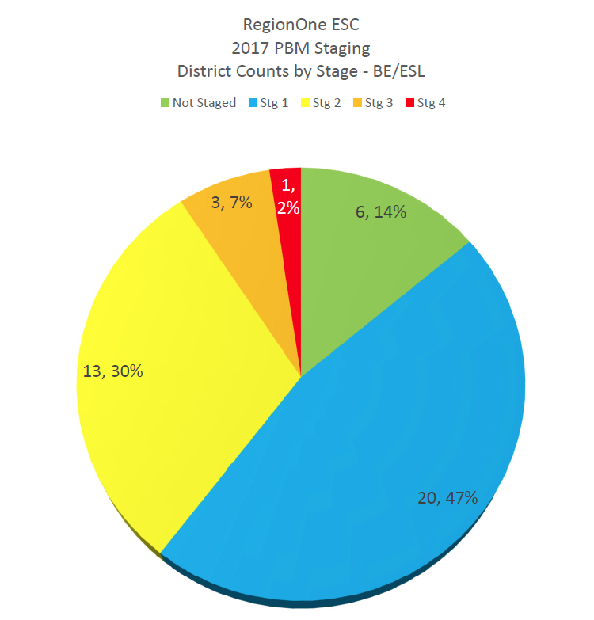
Notes:
11:15 AM

Slide 87
Data
Process
Reporting
State
Districts & Campuses
IR or Met Standard
Indexes & Safeguards
Data Analysis
Needs Assessment
Targeted Improvement
Plan with
Progress Reports
Federal (ESEA Waiver)
Districts & Campuses
Priority and Focus
Safeguards
Implement & Monitor
Improvement Plan
Performance-Based Monitoring (PBM)
Districts
PBMAS
Notes:
Presenter Talking Points:
The continuous improvement process has been designed in such a way that regardless of what accountability rating initiates the engagement to the framework, the continuous improvement process is universally applicable in getting the work done in a targeted way.
Optional Activity: Before the break, give teams a couple minutes to write down or discuss 1 question they may have swirling around at this point and 1 thing that is square in their thinking.
Optional Activity: Share out could be used as a way to welcome group back from the break.

Slide 88

Data Analysis
WHAT
Needs Assessment
WHY
Implement & Monitor
Improvement Plan
HOW
DATA ANALYSIS
Notes:
Facilitator Talking Points:
As mentioned in the opening, the purpose of this training is not to review all required interventions, rather to focus on the most important aspect of the work: engaging in the TAIS continuous improvement process.
Now we are going to take a look at the first quadrant of the continuous improvement process, data analysis.

Slide 89
Steps for Data Analysis
1. Create Inventory of Data Sources
2. Analyze Trends and Patterns
3. Identify the Problem Area
4. Create a Problem Statement
5. Verify Problem Statement

Slide 90

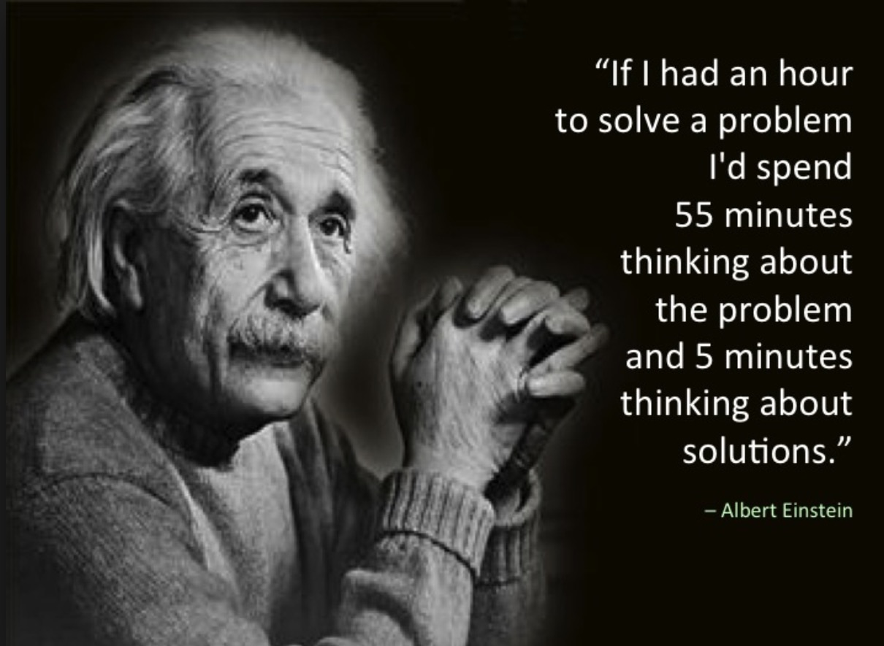
“A problem properly stated is half solved.”
John Dewey
Notes:
Facilitator Talking Points:
Provide the participants time to read this quote. Then inform them that as we move through each section, especially data analysis and needs assessment, the underlying message in this quote w section think about what this quote means to each step in the continuous improvement process.
Facilitation Notes:
Provide the participants time to read this quote.

Slide 91
A well written problem statements is…
Criteria | Y/N
Substantiated by facts/data
Written objectively
Uses concise language
Includes specific details (who, what, when, where)
Focuses on a single, manageable issue
Has relevance to our campus
Avoids causation or assigning solutions
Notes:
Facilitator Talking Points:
To help support the development of a problem statement, the following check list may also be used with your team. Notice that the criteria maintain objective and factual. Again, at this point, we are only exploring what the problems are.
Being that the requirement to develop a targeted improvement plan is to focus on the areas of low performance, it’s possible that teams may only identify 2-3 problem statements.
Keep in mind that, the rest of the plan will be developed further once the problem statements have been generated. At this point in the process you are bringing clarity to what issues need to be addressed in your plan.
Refer to the Problem Statement Checklist handout. This is a resource that you can use in the development of your problems statements.
With this criteria in mind, let’s review a sample problem statement to see if it is well written.
Facilitation Notes:
Have participants access the problem statement checklist
Reiterate that this practice is to become very clear about WHAT the problem are is, not why or how to address it.
Give teams time to review each criteria
Handout 7: Problem Statement Checklist

Slide 92

PROBLEM STATEMENT QUALITY CHECK
ELLs have a 50% pass rate in reading due to a lack of parental involvement
Notes:
Facilitator Talking Points:
Explain that as a group, you will assess the above problem statement according to the criteria in the tool.
Ask that the group help as you assess the problem statement according to each piece of the criteria by giving a “thumbs up,” “thumbs down,” or something in between.
Tell them that the end goal will be to produce an even better problem statement.

Slide 93
PROBLEM STATEMENT QUALITY CHECK
ELLs have a 50% pass rate in reading due to a lack of parental involvement
ELLs have a 50% pass rate in reading
REVISED PROBLEM STATEMENT
Notes:
Facilitator Talking Points:
Here is an example of a revised problem statement that addresses the criteria that were not followed previously.
Perhaps quickly run the new problem statement through the criteria to illustrate – especially highlight no causation and one manageable issue.
Facilitation Notes:
Encourage sharing out, if appropriate.
If the group does not raise the point, explain that when we see the words “due to,” we are assigning blame.
OPTIONAL ACTIVITY
Perhaps give the group some time to re-write the problem statement using the lessons learned from the criteria tool. Have them share out what they came up with. Allow the group to assess each one that is shared.
(7-10min)

Slide 94
Data Analysis
WHAT
Needs Assessment
WHY
Implement & Monitor
Improvement Plan
HOW
NEEDS ASSESSMENT
Notes:
Facilitation Notes:
Transition slide for next step in the process.

Slide 95
Steps for Needs Assessment
Root Cause Analysis
Additional Data Sources
Select Root Cause

Slide 96

WHY?
Notes:
Facilitator Talking Points:
The purpose of the root cause analysis is to identify possible reasons WHY the problem is occurring. Digging beneath the surface of the common assumptions that are often made when attempting to fix the problems we see. Understanding the root cause will lead to a more effective plan that addresses the real issues and is not based on assumptions.
Once we have analyzed the data and gained a clear understanding of what the data says through the development of problem statements, we can effectively begin to drill into WHY these problems exist. The needs assessment, or root cause analysis, will help us understand WHY the problems, or gaps in data, exist.
The root cause is significant because it helps answer WHY the problem (or gap based on data) exists. Determining a reason WHY a gap exists, especially one that isn’t an obvious reason why, gives us insight as to HOW best to address the problem in the planning phase of the process.
The root cause is a hypothesis for the problem statement. This hypothesis sets the context for us to treat the deeper issues, below the surface of the problem statement. This hypothesis is a data grounded, proposed reason why this problem is occurring. However, there are no absolutes when it comes to determining whether or not the “right” root cause has been identified.
The root cause analysis process allows one to drill deep below the surface reasons why. Drilling deep enough helps better identify the root cause, thus allowing us to select the best possible strategy later in the process.
Facilitator Note:
Acknowledge those who may already work with a root cause analysis process.

Slide 97
ROOT CAUSE ANALYSIS PROCESS
PROBLEM STATEMENT
ACTION 1:
  10, 5, 5
ACTION 2:
  Control vs No Control
ACTION 3:
  5 Whys
ROOT CAUSE
Notes:
Facilitator Talking Points:
The first phase of this analysis is called the 10, 5, 5
10, 5, 5---This is a group brainstorming process meant to begin conversations around the possible reasons WHY the problems or gaps exist.
This process establishes multiple hypothesis to a given problem statement.
The purpose of this activity is to stretch brainstorming beyond the surface level or common reasons “why.”
In a minute, starting with the drafted problem statement written on your poster, you’re going to be given time individually to come up with a list of reasons why the problem is occurring AND THEN YOU WILL BE GIVEN TIME TO WORK WHOLE GROUP TO COMBINE YOUR POSSIBLE REASONS WHY THE GAP EXISTS.
There are no wrong answers so record whatever possible reasons come to mind that problem is occurring. However, it’s important to note that data will need to be referenced in order to avoid subjectivity and opinion based reasons moving forward.
Handout 8: Root Cause Analysis activity

Slide 98
ROOT CAUSE ANALYSIS PROCESS
PROBLEM STATEMENT
ACTION 1:
  10, 5, 5
ACTION 2:
  Control vs No Control
ACTION 3:
  5 Whys
ROOT CAUSE
Notes:
Facilitator Talking Points:
Often times we expend energy in solving issues that are beyond our direct control but perhaps we still have influence over.
In order to make urgent changes that have a strong impact, we want to focus our attention on what we can directly control.
So, in this next phase, you will sort through the list of 20 reasons and begin to decide which of those ideas can we control and which might we only have an influence over.

Slide 99
ROOT CAUSE ANALYSIS PROCESS
PROBLEM STATEMENT
ACTION 1:
  10, 5, 5
ACTION 2:
  Control vs No Control
ACTION 3:
  5 Whys
ROOT CAUSE
Notes:
Facilitator Talking Points:
The last phase to this process is called 5 Whys.
Once a consensus has been reached, the 5 Whys will provide an opportunity for teams to dig deeper into why the problem is occurring.
The last answer to the last question becomes the possible root cause.
Know that 5 is not a magic number, it’s possible your team may want to explore up to 7 “whys” and in other cases, only 3.
Let’s revisit our example...

Slide 100
Small Group Discussion
How can I use this information at my campus/district?
Why is it important?

Slide 101
Session Objectives
Content Objective
Today I analyzed different accountability systems and the impact they have on the instruction of English Language Learners.
Language Objective
Today I discuss how different accountability systems impact my school and my district.

Slide 102
Exit Tickets
Write a “Tweet” about something you learned today (120 characters or less).
Don’t forget to hash-tag it!
https://tinyurl.com/ELLDay4

Slide 103
Mil Gracias
See you February 16th!
Karina E. Chapa, M.Ed.
Language Proficiency, Biliteracy and Cultural Diversity Director
kchapa@esc1.net
Facebook: Region One ESC Bilingual
Twitter @esc1bilingual @bilingualpride

